Slide 1



Microsoft
CAPSTONE PROJECT
BLOG MANAGEMENT SYSTEM
Presented By:
1.Ms. H.Jhansi - CMR Engineering College (CMREC)
2.Ms. K.Sai Divya Sri - CMR Engineering College (CMREC)
3.Ms. M.Kusuma - CMR Engineering College (CMREC)
Guided By:
Ankit Dixit

Slide 2
Microsoft
OUTLINE
Abstract
Problem Statement (Should not include solution)
Proposed System/Solution
System Architecture
Algorithm
Conclusion

Slide 3
ABSTRACT
Microsoft
The Blog Management System is a robust and user-friendly platform designed to simplify the creation, organization, and publication of blog content. This system offers bloggers and content creators a comprehensive toolkit for efficient and engaging content management. Key features include content creation and editing tools, media management, SEO optimization, user roles and permissions, and analytical insights. By streamlining the blogging process and enhancing user experience, the Blog Management System empowers individuals and organizations to effectively share their ideas and connect with a global audience.

Slide 4
PROBLEM STATEMENT
Microsoft
Traditional methods of managing blogs often involve complex workflows, lack of standardization, and limited collaboration tools. Bloggers and content creators frequently face challenges related to content organization, SEO optimization, user engagement, and seamless publication processes. Furthermore, with the proliferation of blogs across various niches, the need for effective content management tools has grown exponentially. This highlights the pressing problem: the absence of a comprehensive and accessible Blog Management System that caters to the diverse needs of bloggers and content creators, hindering their ability to produce, manage, and distribute content effectively in today's digital landscape.

Slide 5
PROPOSED SOLUTION
Microsoft
In response to the challenges faced by bloggers and content creators in the realm of traditional blog management, we propose the development of an all-encompassing Blog Management System (BMS). Our BMS will offer an intuitive user interface, standardized workflows, robust SEO optimization tools, and collaborative features that simplify content organization, enhance user engagement, and streamline the publication process. By providing a unified and accessible platform, our solution aims to empower bloggers and content creators across diverse niches, enabling them to efficiently produce, manage, and distribute content in the rapidly evolving digital landscape.

Slide 6
SYSTEM ARCHITECTURE
Microsoft
Our Blog Management System (BMS) will follow a modular architecture, consisting of a front-end user interface, a back-end server, and a database. The front-end will be built using HTML, CSS, and JavaScript for an intuitive user experience. The back-end will utilize server-side scripting (e.g., PHP) to handle user requests, content management, and database interactions. The database, preferably a relational database system, will store blog content, user data, and system configurations. Additionally, the system will incorporate RESTful APIs for seamless integration with external services and social media platforms, enhancing user engagement and content distribution.

Slide 7
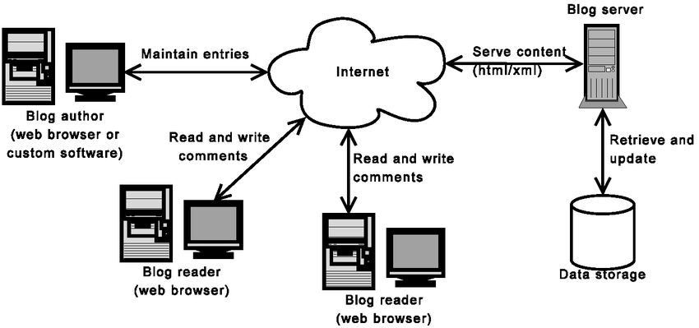

Slide 8
ALGORITHM
Microsoft
1. Content Creation Algorithm:
User inputs blog post content.
Content is processed and formatted using a rich text editor.
Images and media are uploaded and embedded into the post.
Drafts and revisions are saved as needed.
2. SEO Optimization Algorithm:
Analyze blog post content for SEO keywords and metadata.
Suggest improvements for title tags, meta descriptions, and headers.
Provide recommendations for optimizing images and links.
KUISHUGDAH

Slide 9
Microsoft
3. User Engagement Algorithm:
Track user interactions, such as comments and social media shares.
Analyze user behavior to provide personalized content recommendations.
Send notifications for new blog posts and comments.
4. Publication Process Algorithm:
Schedule posts for automatic publication.
Ensure cross-platform compatibility for sharing on social media.
Notify subscribers and followers upon publication

Slide 10
CONCLUSION
Microsoft
The Blog Management System offers a comprehensive solution to the challenges faced by bloggers and content creators. By streamlining content creation, optimizing for SEO, enhancing user engagement, and simplifying the publication process, it empowers users to efficiently manage their digital content. The system's modular architecture and thorough deployment ensure reliability and scalability.

Slide 11
Microsoft
THANK YOU

